Slide 1

Chapter 2 Application Layer
A note on the use of these PowerPoint slides:
We’re making these slides freely available to all (faculty, students, readers). They’re in PowerPoint form so you see the animations; and can add, modify, and delete slides (including this one) and slide content to suit your needs. They obviously represent a lot of work on our part. In return for use, we only ask the following:
If you use these slides (e.g., in a class) that you mention their source (after all, we’d like people to use our book!)
If you post any slides on a www site, that you note that they are adapted from (or perhaps identical to) our slides, and note our copyright of this material.
For a revision history, see the slide note for this page.
Thanks and enjoy! JFK/KWR
All material copyright 1996-2020
J.F Kurose and K.W. Ross, All Rights Reserved
Computer Networking: A Top-Down Approach 8th edition n Jim Kurose, Keith Ross Pearson, 2020
Notes:
Version History
8.1. Updates throughout, including a lot more animations. These are the ppt files used to make Chapter 2 online lectures in Sept. 2020.
8.0 (April 2020)
All slides reformatted for 16:9 aspect ratio
All slides updated to 8th edition material
Use of Calibri font, rather that Gill Sans MT
Add LOTS more animation throughout

Slide 2
Multimedia: audio
analog audio signal sampled at constant rate
telephone: 8,000 samples/sec
CD music: 44,100 samples/sec
each sample quantized, i.e., rounded
e.g., 2⁸=256 possible quantized values
each quantized value represented by bits, e.g., 8 bits for 256 values
quantization error
quantized value of
analog value
analog
signal
audio signal amplitude
time
sampling rate
(N sample/sec)

Slide 3
Multimedia: audio
example: 8,000 samples/sec, 256 quantized values: 64,000 bps
receiver converts bits back to analog signal:
some quality reduction
example rates
CD: 1.411 Mbps
MP3: 96, 128, 160 kbps
Internet telephony: 5.3 kbps and up
quantization error
quantized value of
analog value
analog
signal
audio signal amplitude
time
sampling rate
(N sample/sec)

Slide 4
Voice Packets
Source
Sampling, Encoding, Packetization
Typical packetization time of 10-20ms per audio frame.
Synchronous information stream
Various encoding standards

Slide 5
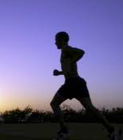
Multimedia: video
spatial coding example: instead of sending N values of same color (all purple), send only two values: color value (purple) and number of repeated values (N)
video: sequence of images displayed at constant rate
e.g., 24 images/sec
digital image: array of pixels
each pixel represented by bits
coding: use redundancy within and between images to decrease # bits used to encode image
spatial (within image)
temporal (from one image to next)
……………………..
……………….…….
frame i
temporal coding example: instead of sending complete frame at i+1, send only differences from frame i
frame i+1

Slide 6
Multimedia: video
spatial coding example: instead of sending N values of same color (all purple), send only two values: color value (purple) and number of repeated values (N)
CBR: (constant bit rate): video encoding rate fixed
VBR: (variable bit rate): video encoding rate changes as amount of spatial, temporal coding changes
examples:
MPEG 1 (CD-ROM) 1.5 Mbps
MPEG2 (DVD) 3-6 Mbps
MPEG4 (often used in Internet, < 1 Mbps)
……………………...…
……………………...…
frame i
temporal coding example: instead of sending complete frame at i+1, send only differences from frame i
frame i+1

Slide 7
Video Packets
Source
Sampling, Encoding, Packetization
Variable bit rate information stream
Various encoding standards

Slide 8
Multimedia networking: 3 application types
streaming, stored audio, video
streaming: can begin playout before downloading entire file
stored (at server): can transmit faster than audio/video will be rendered (implies storing/buffering at client)
e.g., YouTube, Netflix, Hulu
conversational voice/video over IP
interactive nature of human-to-human conversation limits delay tolerance
e.g., Skype
streaming live audio, video
e.g., live sporting event (futbol)

Slide 9


Streaming stored video
simple scenario:
Internet
video server
(stored video)
client
Main challenges:
server-to-client bandwidth will vary over time, with changing network congestion levels (in house, access network, network core, video server)
packet loss, delay due to congestion will delay playout, or result in poor video quality

Slide 10
Streaming stored video
Cumulative data
2. video
sent
video
recorded (e.g., 30 frames/sec)
3. video received, played out at client
(30 frames/sec)
network delay
(fixed in this example)
time
streaming: at this time, client playing out early part of video, while server still sending later part of video

Slide 11
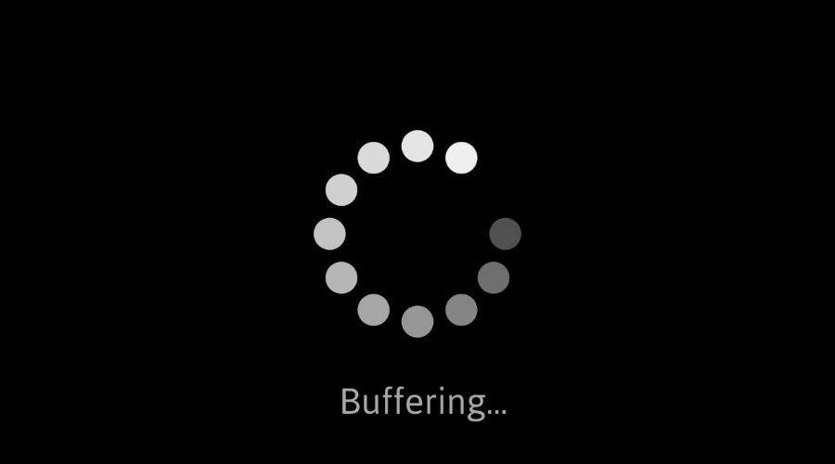
Streaming stored video: challenges
continuous playout constraint: during client video playout, playout timing must match original timing
… but network delays are variable (jitter), so will need client-side buffer to match continuous playout constraint
other challenges:
client interactivity: pause, fast-forward, rewind, jump through video
video packets may be lost, retransmitted

Slide 12
Streaming stored video: playout buffering
constant bit
rate video
transmission
client video
reception
constant bit
rate video
playout at client
Cumulative data
variable
network
delay
buffered
video
client playout
delay
time
client-side buffering and playout delay: compensate for network-added delay, delay jitter

Slide 13

Client-side buffering, playout
buffer fill level, Q(t)
variable fill
rate, x(t)
playout rate,
e.g., CBR r
video server
client application
buffer, size B
client

Slide 14
Client-side buffering, playout
buffer fill level, Q(t)
variable fill
rate, x(t)
playout rate,
e.g., CBR r
video server
client application
buffer, size B
client
1. Initial fill of buffer until playout begins at t_{p}
2. playout begins at t_{p,}
3. buffer fill level varies over time as fill rate x(t) varies and playout rate r is constant

Slide 15
Client-side buffering, playout
buffer fill level, Q(t)
variable fill
rate, x(t)
playout rate,
e.g., CBR r
video server
client application
buffer, size B
playout buffering: average fill rate (x), playout rate (r):
initial playout delay tradeoff: buffer starvation less likely with larger delay, but larger delay until user begins watching

Slide 16
Streaming multimedia: UDP
server sends at rate appropriate for client
often: send rate = encoding rate = constant rate
transmission rate can be oblivious to congestion levels
short playout delay (2-5 seconds) to remove network jitter
error recovery: application-level, time permitting
RTP [RFC 2326]: multimedia payload types
UDP may not go through firewalls

Slide 17

Streaming multimedia: HTTP
multimedia file retrieved via HTTP GET
send at maximum possible rate under TCP
fill rate fluctuates due to TCP congestion control, retransmissions (in-order delivery)
larger playout delay: smooth TCP delivery rate
HTTP/TCP passes more easily through firewalls
variable rate, x(t)
video
file
TCP send buffer
TCP receive buffer
application playout buffer
server
client

Slide 18
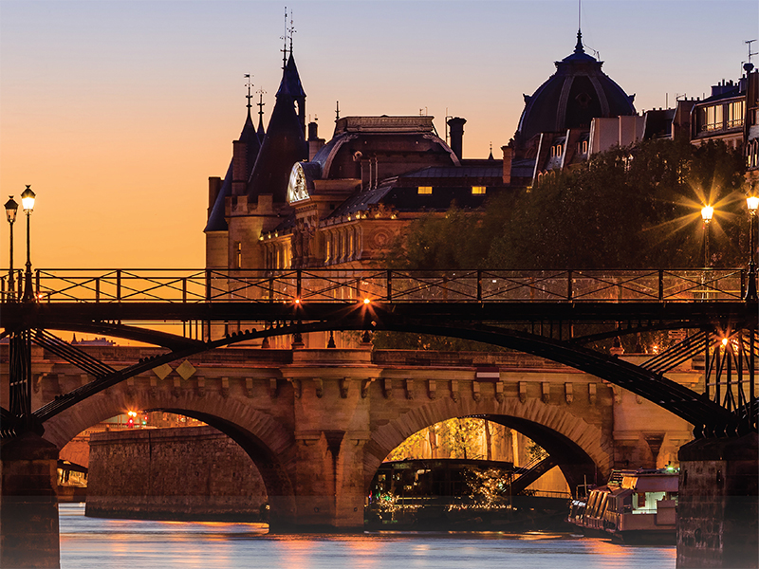
Transport layer: roadmap
Transport-layer services
Multiplexing and demultiplexing
Connectionless transport: UDP
Principles of reliable data transfer
Connection-oriented transport: TCP
Principles of congestion control
TCP congestion control
Evolution of transport-layer functionality

Slide 19
Evolving transport-layer functionality
TCP, UDP: principal transport protocols for 40 years
different “flavors” of TCP developed, for specific scenarios:
Scenario | Challenges
Long, fat pipes (large data transfers) | Many packets “in flight”; loss shuts down pipeline
Wireless networks | Loss due to noisy wireless links, mobility; TCP treat this as congestion loss
Long-delay links | Extremely long RTTs
Data center networks | Latency sensitive
Background traffic flows | Low priority, “background” TCP flows
moving transport–layer functions to application layer, on top of UDP
HTTP/3: QUIC

Slide 20
QUIC: Quick UDP Internet Connections
application-layer protocol, on top of UDP
increase performance of HTTP
deployed on many Google servers, apps (Chrome, mobile YouTube app)
HTTP/2
HTTP/2 (slimmed)
Application
HTTP/3
TLS
QUIC
Transport
TCP
UDP
Network
IP
IP
HTTP/2 over TCP
HTTP/2 over QUIC over UDP

Slide 21
QUIC: Quick UDP Internet Connections
adopts approaches we’ve studied in this chapter for connection establishment, error control, congestion control
error and congestion control: “Readers familiar with TCP’s loss detection and congestion control will find algorithms here that parallel well-known TCP ones.” [from QUIC specification]
connection establishment: reliability, congestion control, authentication, encryption, state established in one RTT
multiple application-level “streams” multiplexed over single QUIC connection
separate reliable data transfer, security
common congestion control

Slide 22

QUIC: Connection establishment
TCP handshake
(transport layer)
QUIC handshake
data
TLS handshake
(security)
data
TCP (reliability, congestion control state) + TLS (authentication, crypto state)
2 serial handshakes
QUIC: reliability, congestion control, authentication, crypto state
1 handshake

Slide 23
QUIC: streams: parallelism, no HOL blocking
HTTP
GET
HTTP
GET
HTTP
GET
HTTP
GET
HTTP
GET
application
HTTP
GET
QUIC
encrypt
QUIC
encrypt
QUIC
encrypt
QUIC
encrypt
QUIC
encrypt
QUIC
encrypt
TLS encryption
TLS encryption
QUIC
RDT
QUIC
RDT
QUIC
RDT
QUIC
RDT
QUIC
RDT
QUIC
RDT
error!
QUIC Cong. Cont.
QUIC Cong. Cont.
TCP RDT
TCP RDT
error!
transport
TCP Cong. Contr.
TCP Cong. Contr.
UDP
UDP
(a) HTTP 1.1
(b) HTTP/2 with QUIC: no HOL blocking

